Slide 1


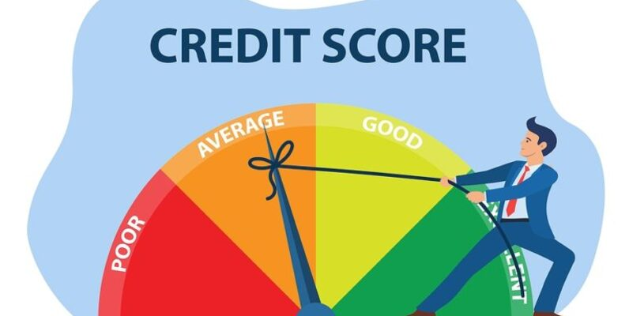
https://www.kaggle.com/datasets/parisrohan/credit-score-classification
Notes:
הפרויקט נעשה על דירוג אשראי, מאגר הנתונים הובא מהאתר קאגל.

Slide 2
Project background and context
A credit score is a numerical representation of an individual's creditworthiness, indicating the likelihood that they will repay borrowed money or fulfill financial obligations.
Bias in credit scoring can significantly impact individuals by creating disparities in access to financial opportunities.
Problems you want to find answers
possibility of predicting a person's status
checking whether our model is biased by age or profession
Occupation: Bias may arise if certain occupations are systematically favored or penalized in the credit scoring process.
Age: bias in credit scores can disadvantage younger individuals due to limited credit histories, potentially affecting their access to favorable financial terms.
Notes:
דירוג האשראי הוא הצגה של כדאיות מתן הלוואה לבן אדם לפי הנתונים הכספיים שלו. אפליה בתחום זה יכולה לפגוע באופציות פיננסיות של הבן אדם המופלה כמו למשל קבלת משכנתא

Slide 3
Credit score data
our initial data is 26 predictors (X) and 1 explained variable, 10,000 observations which we will divide 9:1 for test and train
explained variable- credit_score:
Name | count | interest
Standard | 53174 | 53.17%
Poor | 28998 | 28.99%
Good | 17828 | 17.82%
Notes:
ה-DATA של דירוג האשראי מורכב מאוסף נתונים בנקאים ומידע של נתוני אשראי.

Slide 4

Perform data wrangling
There are missing values in the provided data that are sometimes displayed as an incomprehensible set of characters, but thanks to the features of our data, we can fill them in without problems
transformation of variables into formats suitable for the model

Slide 5
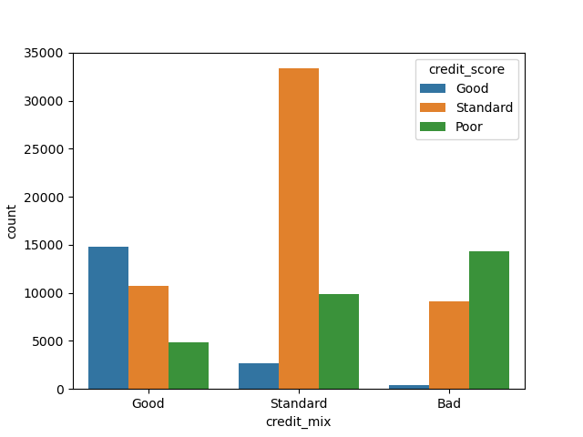
Perform exploratory data analysis (EDA)
Credit mix-Represents the classification of the mix of credits
1
we see a direct relationship between the variables
2

Slide 6
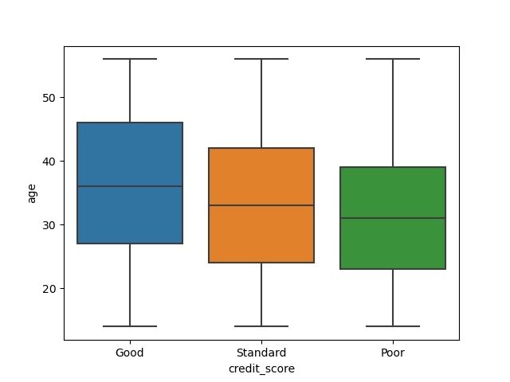
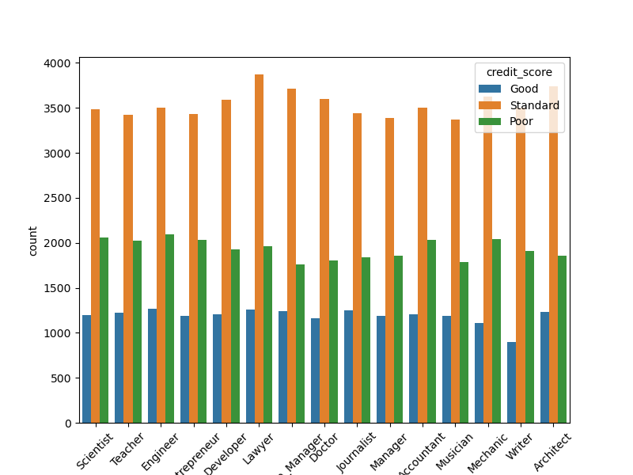
slight differences in age are visible between
we see that the distribution of credit scores is approximately the same for all professions
Notes:
מבחינת אפליה בעיסוק שיכול להיגרם בדירוג אשראי, אנחנו רואים לפי גרף התפלגות דירוג אשראי לפי עיסוק שאין חריגות משמעותיות שיכולות להעיד על אפליה בתחום זה.

Slide 7

Multicollinearity test
Correlation test
checking the correlation between variables and showed a high dependence between monthly and annual income
VIF
vfi check revealed 2 variables: monthly in hand salary and number of loans
remove these variables to avoid multicollinearity

Slide 8
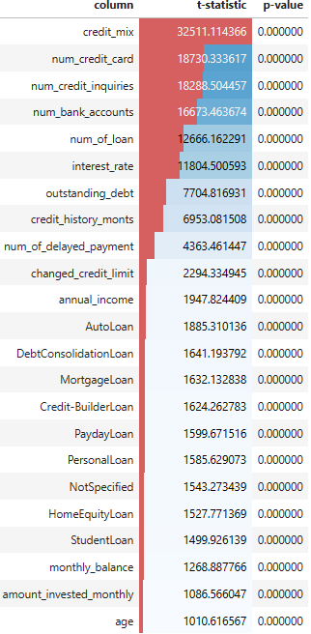
Testing Hypotheses Using Chi-Square and F-Tests
We conduct hypothesis testing to evaluate the relationship between the categorical and numeric columns in the DataFrame and the target variable "credit_score". The results include the test statistic and p-value for each column, which helps identify the important factors influencing "credit_score".
for further work we have left only variables with p-value equal to 0

Slide 9
Model selection
model | F1-score
Random Forest | 0.83
Decision Tree | 0.79
Gradient Boosting | 0.76
XGBoost | 0.75
CatBoost | 0.72
AdaBoost | 0.67
KNN | 0.82
LR | 0.66
Voting Classifier RF&KNN | 0.83

Slide 10
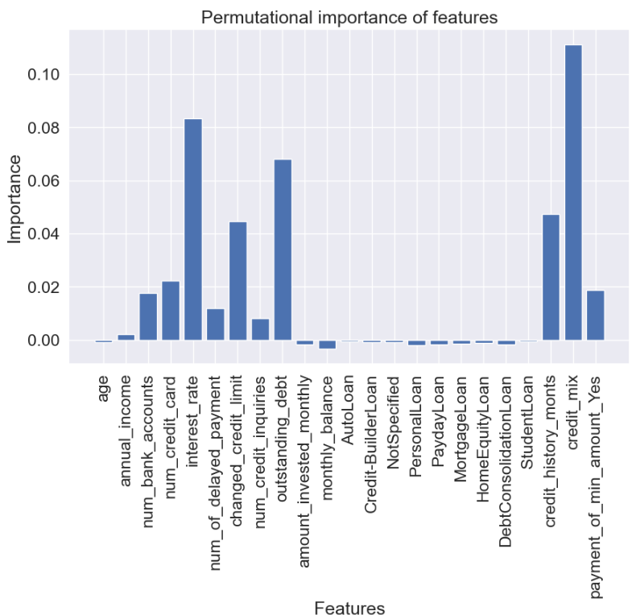
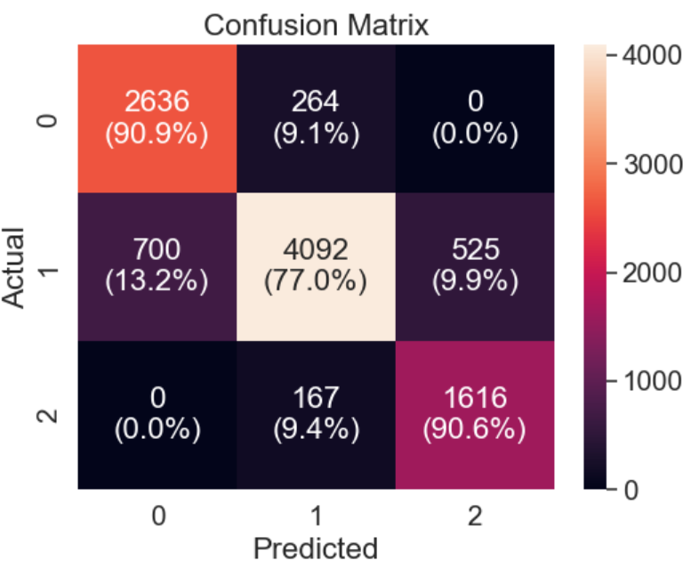
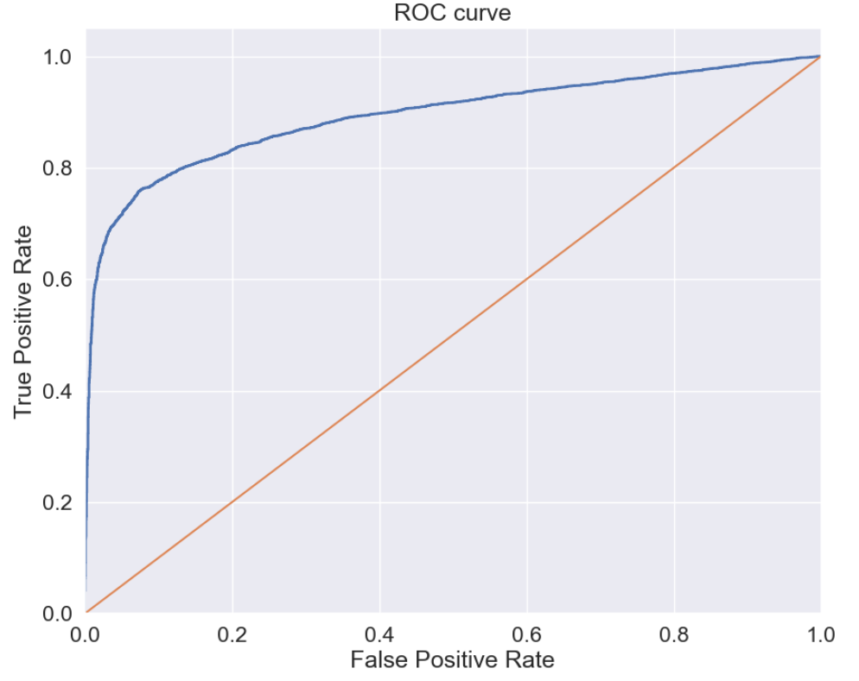
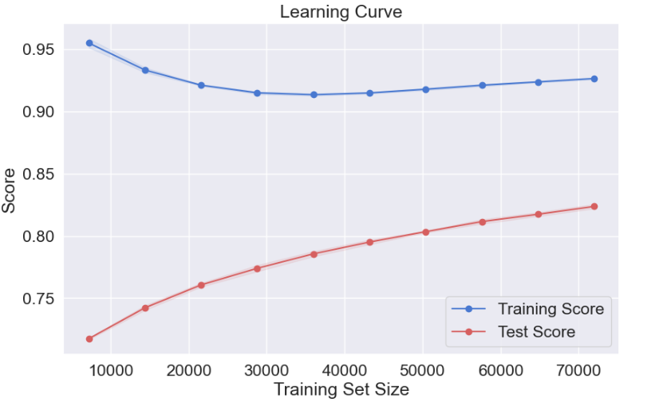
Random forest
 | precision | recall | f1-score
0 | 0.79 | 0.91 | 0.85
1 | 0.90 | 0.77 | 0.83
2 | 0.75 | 0.91 | 0.82
accuracy |  |  | 0.83
macro avg | 0.82 | 0.86 | 0.83
weighted avg | 0.84 | 0.83 | 0.83

Slide 11
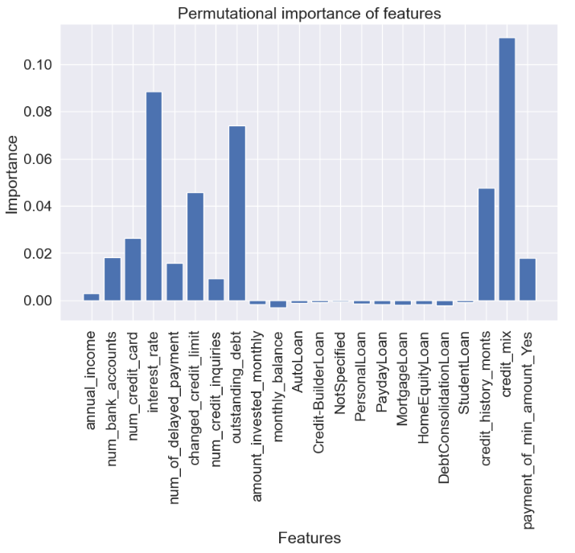
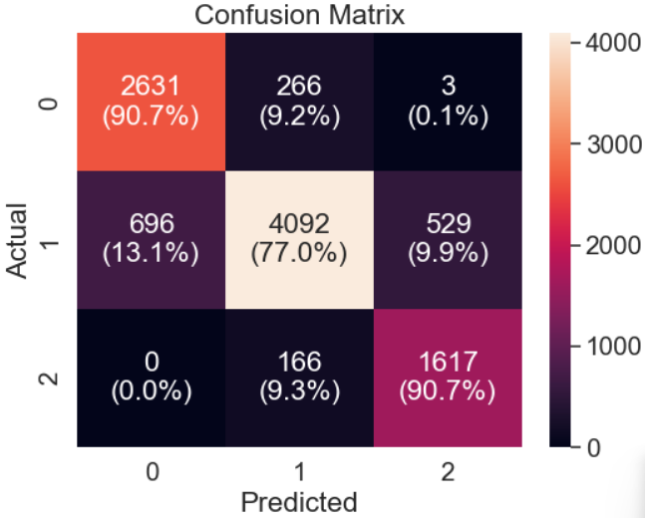
Random forest minus age
 | precision | recall | f1-score
0 | 0.79 | 0.91 | 0.85
1 | 0.90 | 0.77 | 0.83
2 | 0.75 | 0.91 | 0.82
accuracy |  |  | 0.83
macro avg | 0.82 | 0.86 | 0.83
weighted avg | 0.84 | 0.83 | 0.83

Slide 12
T-test Predicted Values ,age,occupation
Age not In X
All predicted
column | t-statistic | p-value
age | 5.665345 | 0.003475
occupation | 33.510437 | 0.217457
Age In X
All predicted
column | t-statistic | p-value
age | 5.426141 | 0.004413
occupation | 35.090502 | 0.167248
False predicted
column | t-statistic | p-value
age | 4.502833 | 0.011213
occupation | 31.717878 | 0.286143
False predicted
column | t-statistic | p-value
age | 4.168822 | 0.015633
occupation | 32.626750 | 0.249760

Slide 13
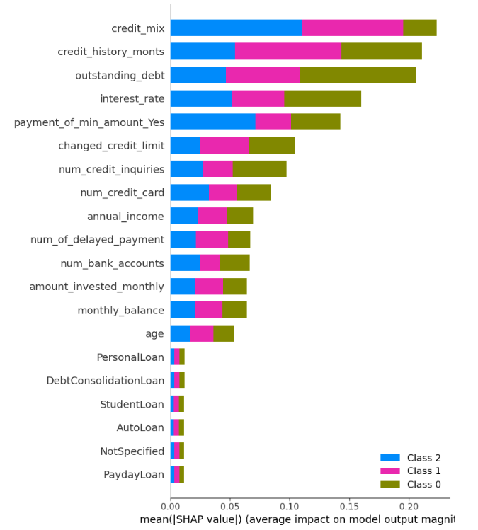
shap

Slide 14
fare

Slide 15


Conclusions

